Slide 1
What is Sociology?

Slide 2
What is Sociology?
Soci- (relating to society) + -ology (the study of)
Sociology: SCIENCE of society/the social
  What is Science?: systematic and objective efforts to explain and predict phenomena through observation, empirical testing and replication of tests, and building of theory based on this empirical work, i.e., the single best, most reliable form of knowledge yet arrived at by humans
None of the founders of the discipline even entertained the idea (which is, unfortunately, increasingly widespread among contemporary sociologists, especially in the US) that humans are somehow outside the purview of scientific inquiry (because e.g., we are too complex, or we are self-conscious, or we have souls, or we are just super special in some undetermined, unargued way)

Slide 3
Sociology is...
  independent of and indifferent to all moral and political position-taking and advocacy
    however, those who are involved in trying to change society in one way or another would do well to study and understand scientifically-generated knowledge about human behavior and society in order to tailor their moral and political desires to the limits of reality
  geared, in the measure possible, toward the establishment of baseline theoretical statements about human nature, human behavior, human culture, human cognition, and human emotion everywhere, i.e., crude cultural and moral relativism are rejected as there is too much evidence against them
    e.g., if human nature is infinitely plastic, where are the cultures in which women are more violent than men? Answer: there are none, it is a human universal that males are on average more violent than females

Slide 4
Sociology is...
  eager to mine other sciences for knowledge they have produced for use in the study of human beings
  based and reliant always on evidence, evidence, evidence, with no speculation or theorizing or a priori guesswork to survive the challenge of systematic contradictory evidence
    e.g., if you theorize that the development of capitalism will cause the pauperization and the heightened political radicalism of the working classes, and this does not happen, you must either adjust or throw out your theory, and if you continue to adhere to the unmodified theory in the face of the evidence, you have a religion, not a scientific theory
  fundamentally statistical and generalizing
    anecdotal accounts or events do not undermine statistical generalizations—e.g., ‘the research shows that stepchildren are statistically more likely than biological children to be abused and neglected, but this must be incorrect because my stepfather is really nice to me!’

Slide 5
Elements for an Evolutionary Understanding of Human Behavior and Society

Slide 6
Against the ‘tabula rasa/Blank Slate’ view of human nature
The Blank Slate claim is that there’s nothing innate or given by biology in our species
  i.e., human beings are more or less infinitely malleable and it’s experience and socialization that make us what we are, with no real contribution from our biology
This is based on the conceit that humans are somehow completely separate from the rest of life in terms of processes that produce and affect us
Ubiquitous partial heritability thesis: genetic differences are partial causes of the overwhelming majority of individual-level outcomes of interest to psychological and social science
  About half of the variation in intelligence, personality, and life outcomes is heritable, i.e., an indirect product/correlate of genes.

Slide 7
Elementary Sociobiology of humans: A few important pieces of human nature
Natural selection: works at level of individual organism, not ‘species’
  Kin selection and reciprocal altruism as auxiliaries of individual selection
  We should therefore expect selfishness as default
Sex differences: a sexual division of labor and other important consequences follow from basic facts of human reproduction (anisogamy)
  Asymmetries in mate preferences and parenting roles
  Oxytocin (hormone) and mammalian attachment bond between mother and offspring
  Differences in sexual jealousy and predilection to violent aggression motivated by sex
  Disproportionate amount of violence involves young males, competing with other young males or attempting to prevent women with whom they have been sexually involved from ‘straying’ (statistically, the single most dangerous man for any woman is an ex-boyfriend or ex-husband)
    Bateman-Trivers principle: access to the sex that makes the greater parental investment tends to become the crucial resource limiting the fitness of individuals of the less investing sex, so that selection favors competition among the latter for access to mates i.e., males pursue females and fight with each other over them—intrasexual selection
Importance of learning: high cognitive function (neocortex)
Importance of emotion: great ape (subcortical) brains built for intense emotional experience, especially sexual pleasure
Preference for in-group and dislike of out-groups (ethnocentrism)

Slide 8
Sex difference in H. sapiens

Slide 9
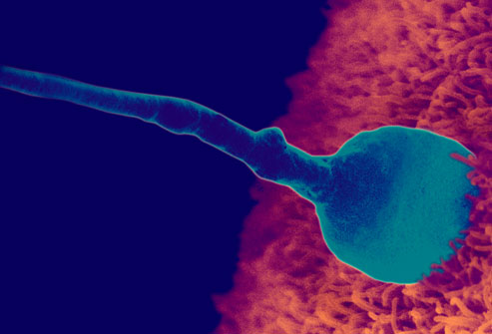
Sex difference and H. sapiens
What is it, at root, to be male or to be female?
  Differential contribution to reproduction, and concomitant difference in parental investment as a direct consequence of the former
  Sperm vs. Egg
  Mammalian maternal gestation (placenta and lactation)

Slide 10
What follows from sexual difference?
Sexual division of labor and other important consequences follow from basic facts of human reproduction
  Asymmetries in mate preferences and parenting roles
  Oxytocin (hormone) and mammalian attachment bond between mother and offspring
  Bateman-Trivers principle: access to the sex that makes the greater parental investment tends to become the crucial resource limiting the fitness of individuals of the less investing sex, so that selection favors competition among the latter for access to mates i.e., males pursue females and fight with each other over them
  Sexual dimorphism
  Differences in sexual jealousy and predilection to violent aggression motivated by sex

Slide 11
Aggression, Violence, and sex difference
What do we know about violence in H. sapiens?
men tend to do it, and especially the more extreme manifestations of the ‘male brain’
young men are even more statistically likely to commit acts of aggression and violence
a very small subset of young men commit a very disproportionate number of violent acts
a good deal of young male sexual violence has to do with competition for women, or efforts to prevent women from straying to other men (e.g., statistically speaking, the single most dangerous man in the world to a woman is a boyfriend or spouse, and especially an ex-boyfriend or ex-spouse who suspects the woman of sexual interest in another man)

Slide 12
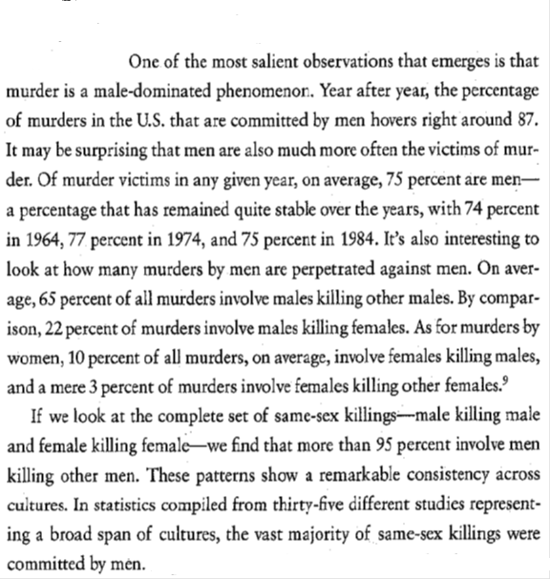

Slide 13
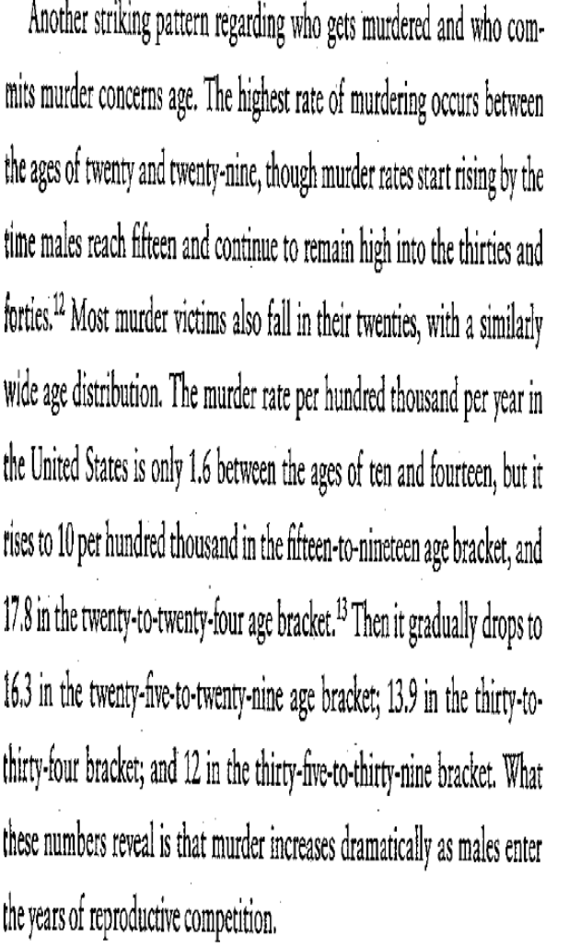

Slide 14
Being Female and Being Male, statistically/probabilistically speaking
(adapted from Baron-Cohen, The Essential Difference)
Female H. sapiens
  Empathy: ability to judge emotion
  Valuing of and skill at social relationships
  Aggression expressed indirectly
  Cooperative, collaborative communication
Male H. sapiens
  Systemizing: ability to discern detail, organize and classify systems
  Valuing of and skill at dominance hierarchies
  Aggression expressed directly
  Assertive, non-collaborative communication

Slide 15
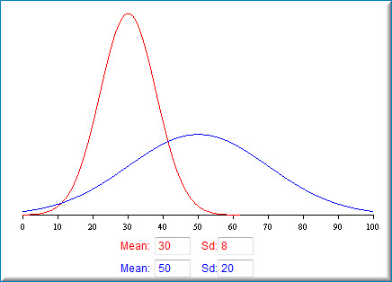
The GMVH (Greater Male Variability Hypothesis

Slide 16
Stratification and human societies

Slide 17
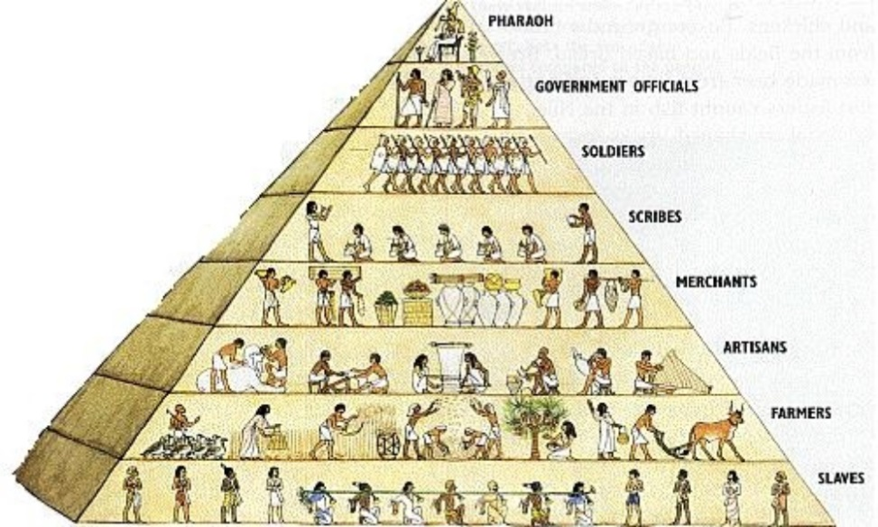
Stratification in human societies: the why and the how
The primate background: dominance orders
Stratification is an inevitable outcome of any relatively complex system with differentiated parts/elements
Social differentiation: as human societies evolve, increasing differentiation has been the rule--more complex division of labor, more specialization, more surplus and variable distribution of material and symbolic goods
Hierarchy in animal societies ultimately related to the maximization principle: rank (on whatever stratification axis—e.g., wealth, status, power) ultimately will relate to competition for fitness

Slide 18
Summary of stratification through the societal types
Hunter-gatherer society: little or no ‘class’ stratification; but stratification on age, sex, and talent/prowess (e.g., hunting, shamanism)
Horticultural society: surplus creates ‘class’ stratification; other stratification axes remain important; increase in slavery
Agrarian society: most highly stratified and unequal societal form we have yet seen; large peasant and expendable classes, tiny governing class; rise of intermediate groups (merchants, priests, artisans)
Industrial society: much more complex stratification systems; inequality decrease from agrarian epoch; massive increase in technology and material prosperity cause ‘all boats to rise’ even if some rise much more than others; greater social mobility than in any previous period

Slide 19
Thinking about stratification in contemporary industrial societies
Dominant sociological theories of stratification (Marxian, Weberian, functionalist) all fail in important ways because they are not sufficiently based in an evolutionary understanding of human nature
The complete failure of radical destratification efforts (e.g., the former Soviet Union and the Communist bloc in Eastern Europe) reveals stratification as a very stubborn feature of human society
The problem of separating analysis of stratification from moralizing about stratification: understanding the phenomenon is not dependent on being morally against it in a universalizing, utopian way, and in fact a utopian moral position on stratification can be and often is a serious impediment to fully understanding it (because one is so concerned to try to eliminate it altogether that one accepts ideas about it that are untrue simply because they seem to indicate that it can be eliminated)

Slide 20
A few good resources (all available in our library)
Gerhard Lenski and Patrick Nolan, Human Societies: An Introduction to Macrosociology
Joseph Lopreato, Human Nature and Biocultural Evolution
Joseph Lopreato and Tim Crippen, Crisis in Sociology: The Need for Darwin
Jonathan Turner and Alexandra Maryanski, On the Origin of Societies by Natural Selection

